Slide 1
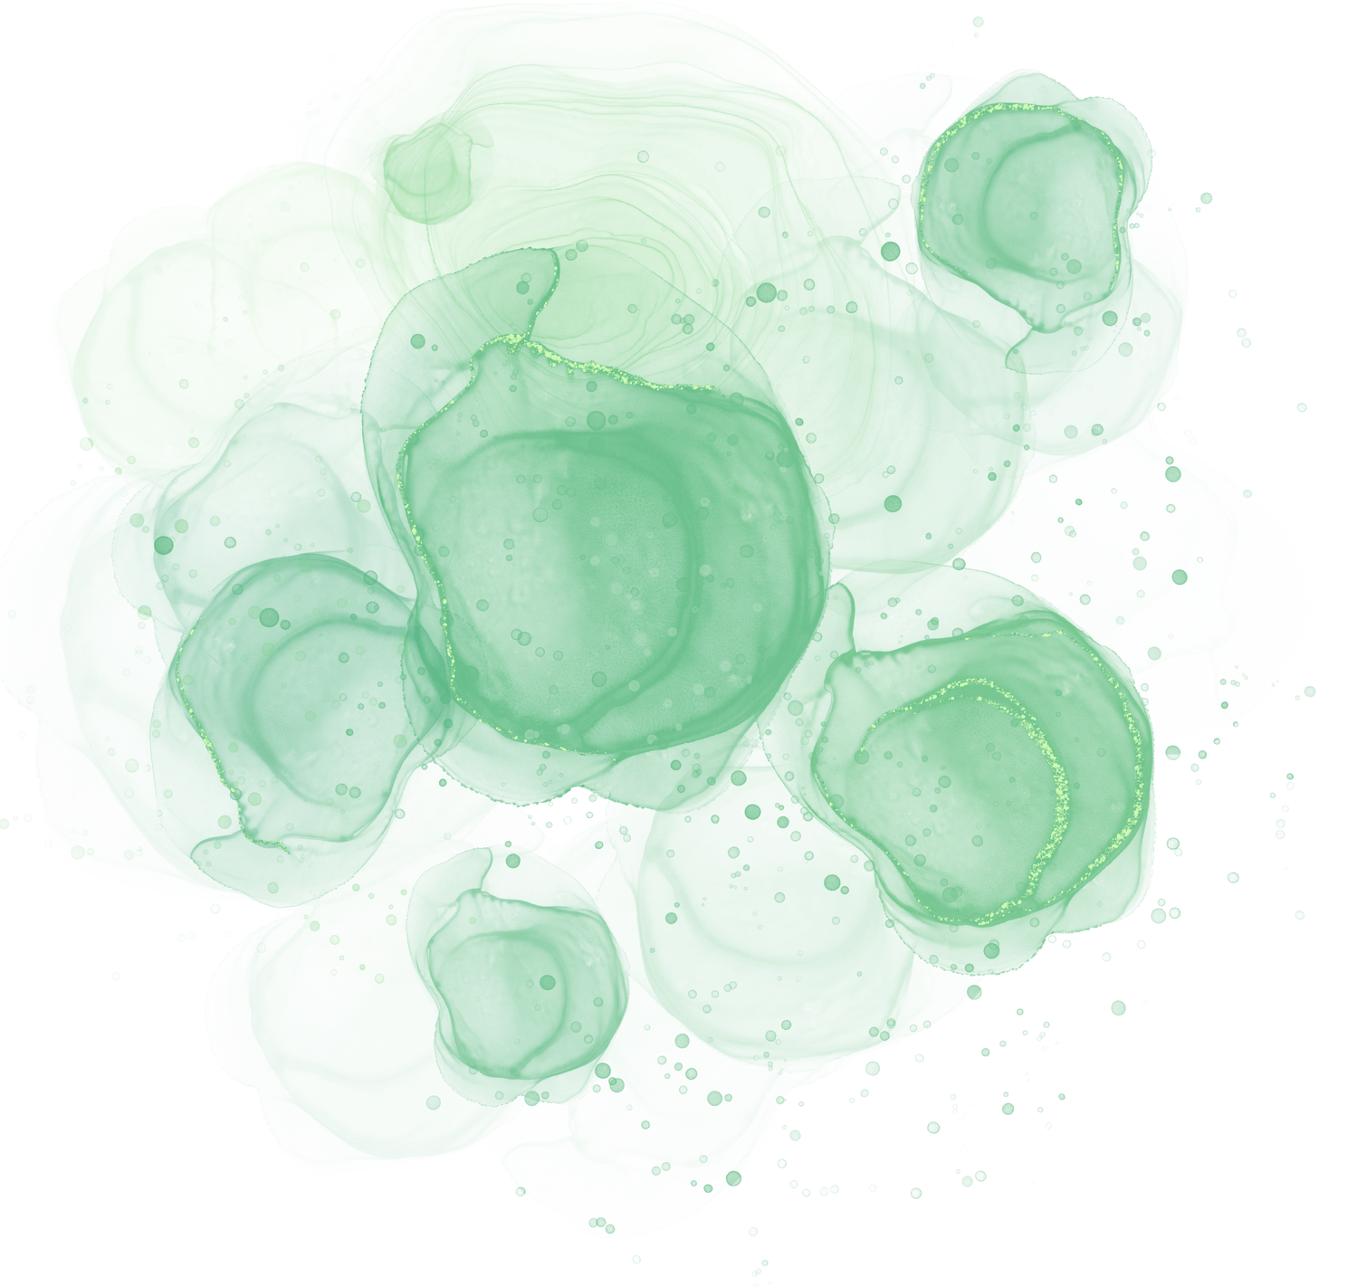

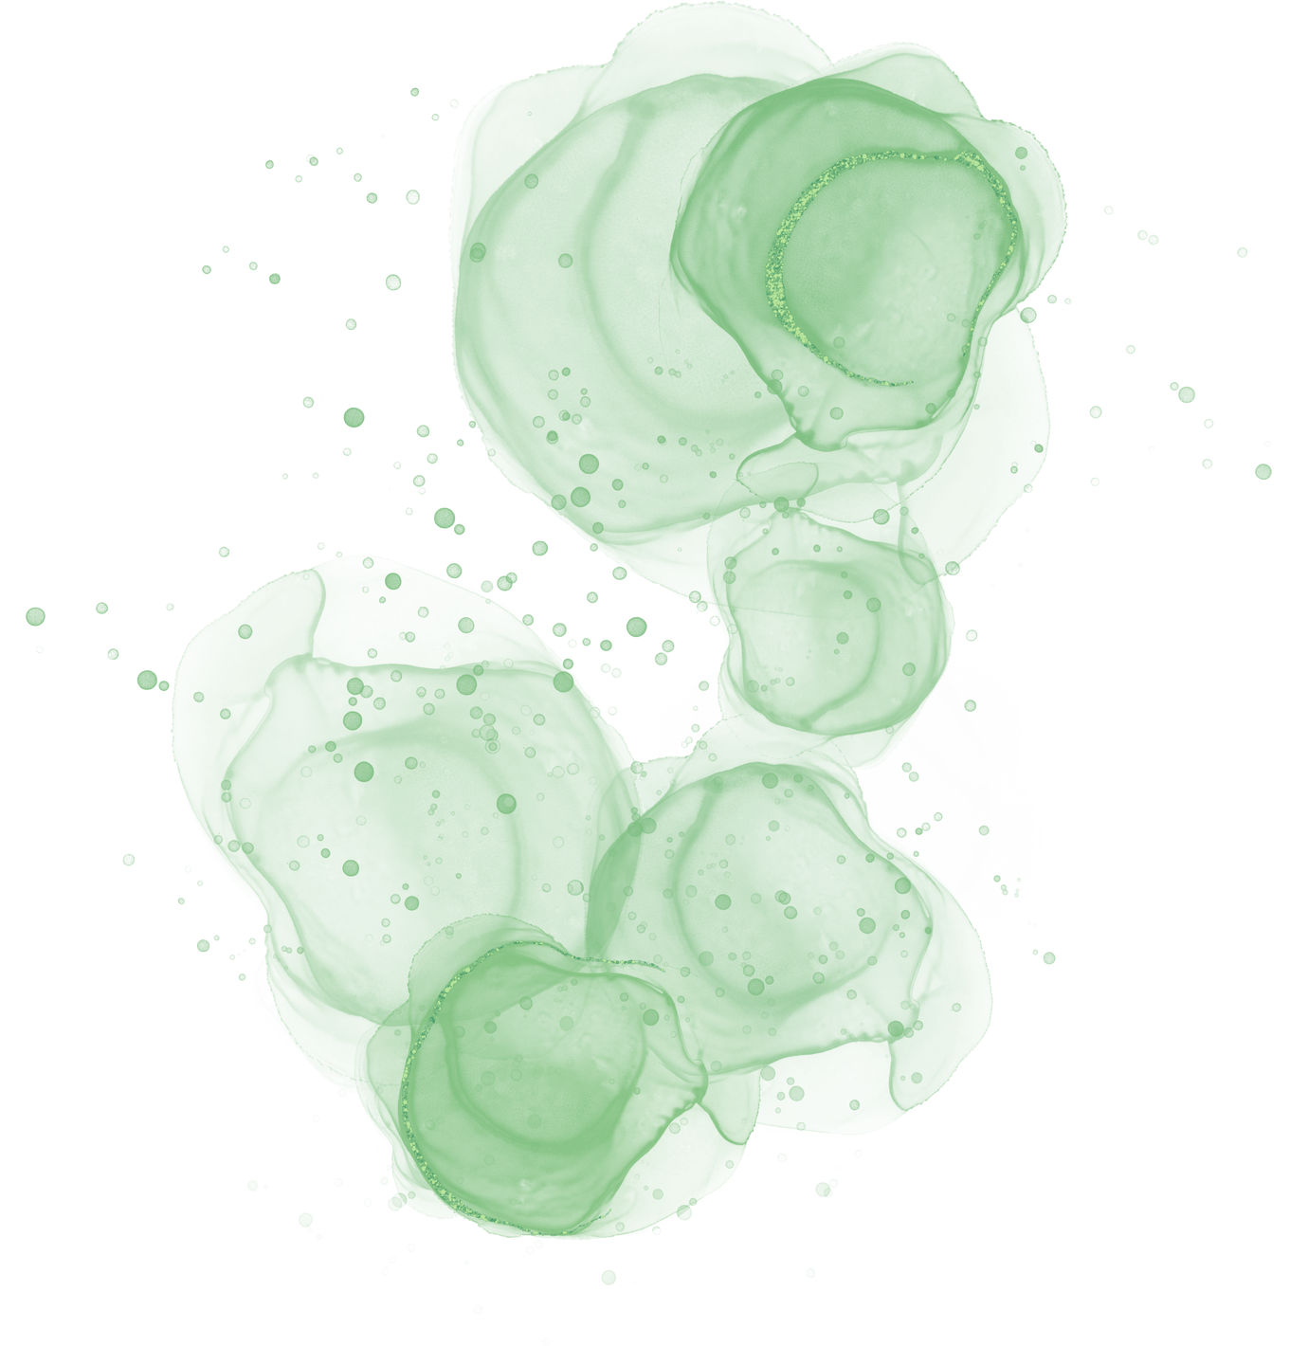







YOUR INNER GODDESS UNLEASHED
Helen E Dickinson
Ten Easy Steps To Be your own goddess

Slide 2
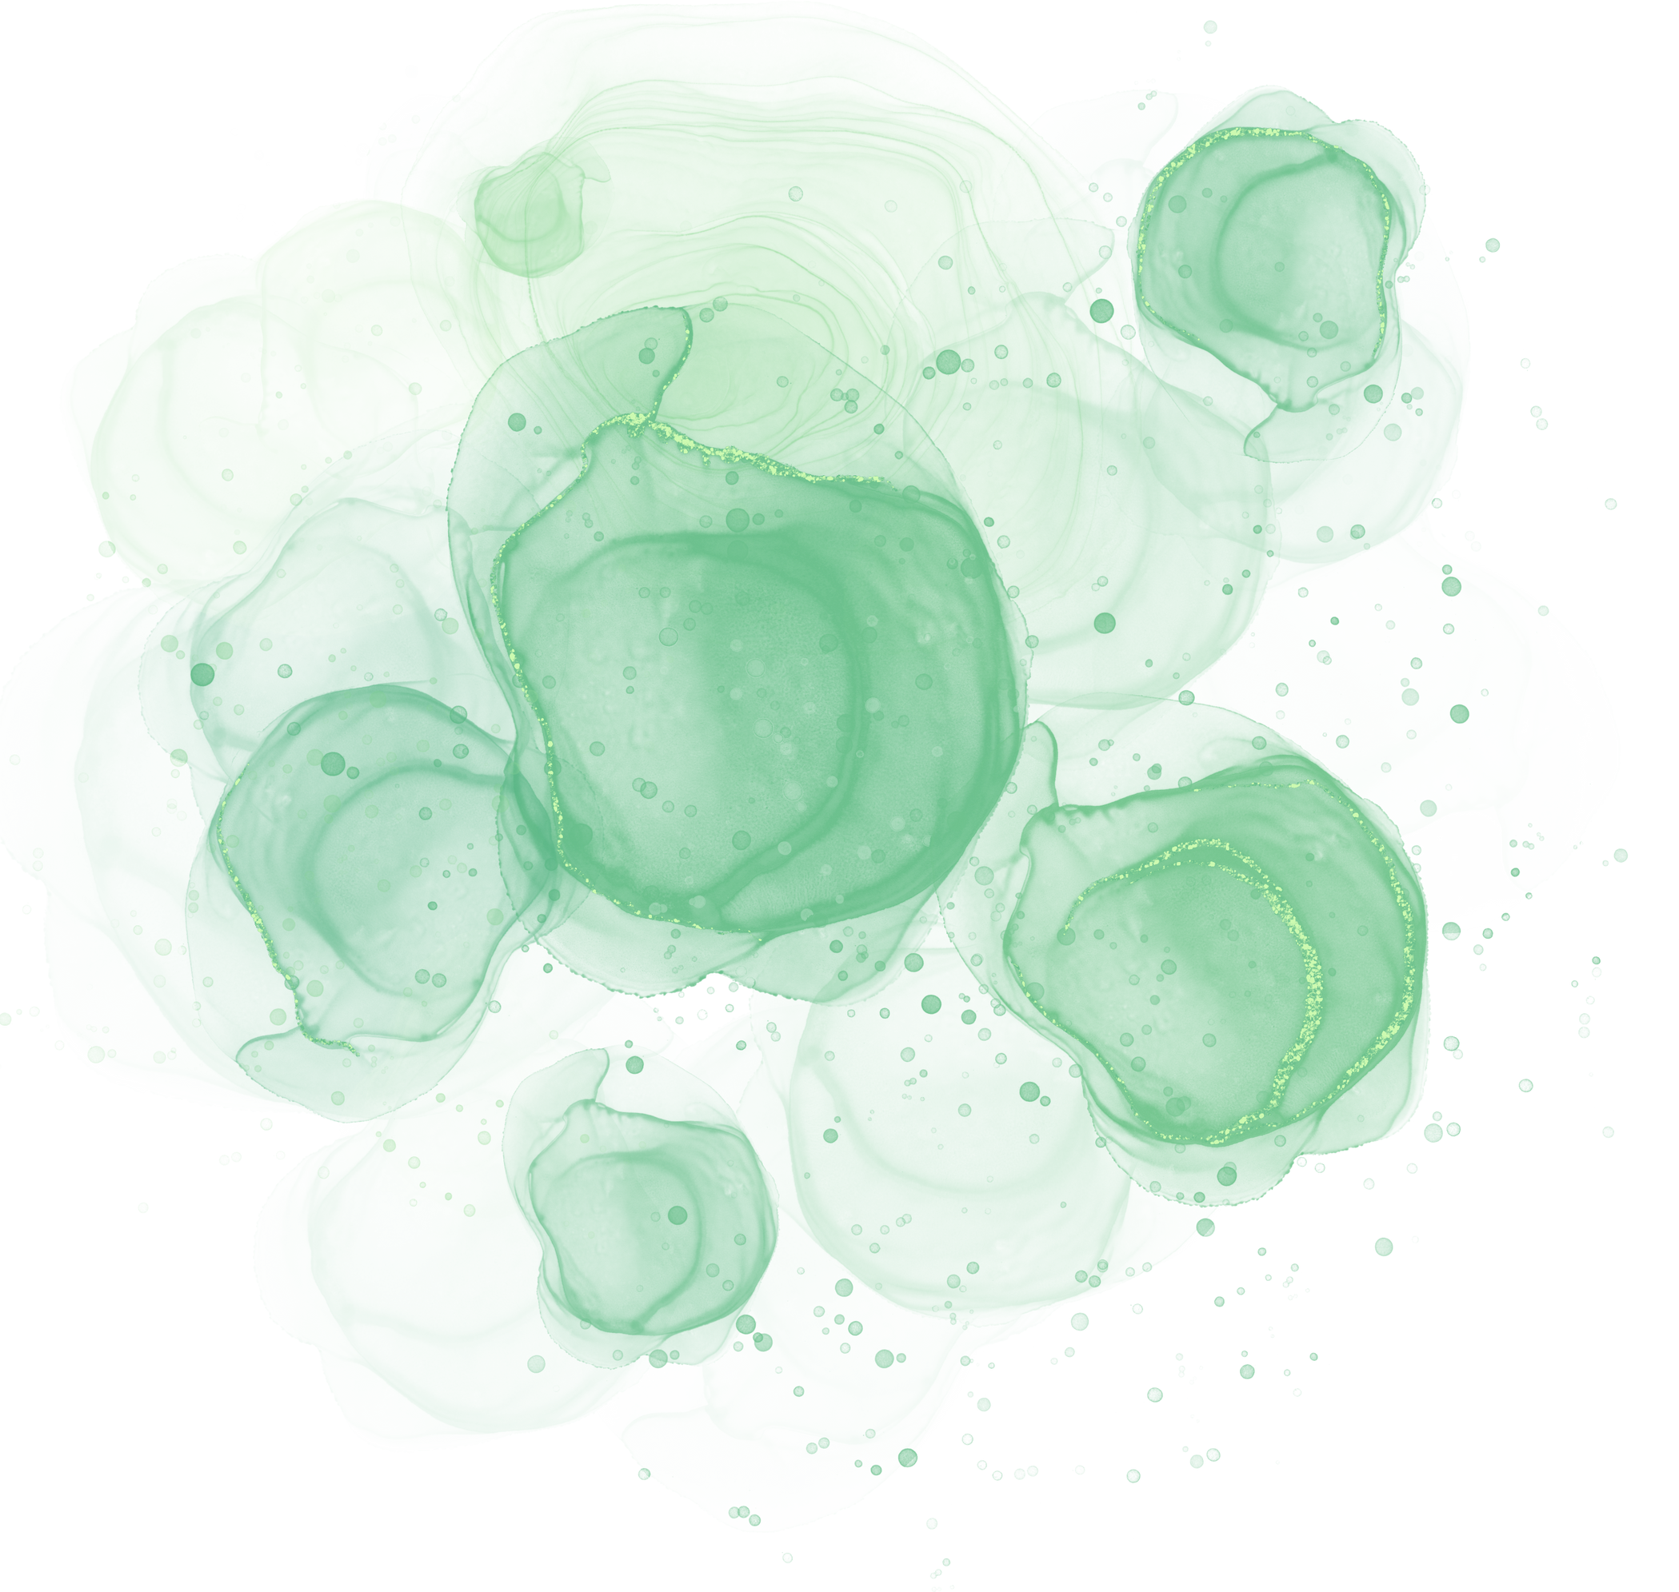


You The Goddess
She who is powerful, sexual, feminine, a warrior, a healer, mother, lover, wife, sister, daughter.
You will find that she is wisdom, innocent, young, old, timeless, dark, pale, yellow, red, skinny, or voluptuous.
She is you!

Slide 3
DEVELOPMENT

Slide 4
EVOLEMENT
Based on a workshop that was hosted myself in 2018. This was originally a 30min talk I gave to a Mind Body and Soul Event in Carlisle a few years before that. With a bit of poking from others I expanded it to create the Unleash You Inner Goddess.
The goddess’s who attended the 2018 workshop on that cold February Sunday at Maryport, Cumbria, have blossomed and I immensely proud of the work that they created that day and since. Creating their own path with the Goddess, my heart overflows knowing that they are continuing the work of the Goddess in the world.

Slide 5

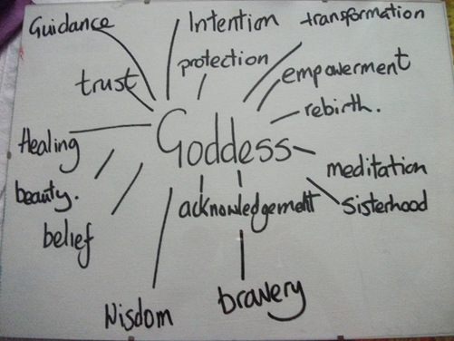

INSPIRATION
This mini course will give you some easy ways to change your life, to embody the goddess and release your hidden one. Whether you are female or male the goddess is a strong force to reckon with. You are given some steps to take with no particular order , but I would advice you to cleanse first.
It is not an academic work but something that can enrich your life. There are many amazing books out there that will give you the knowledge to follow.

Slide 6

MAIDEN, MOTHER, CRONE
·The crone, hag, the wise one feared most of the triple Goddess’s. She is the elder that passes on the wisdom learnt through experience to the maiden. Past childbearing, she is sexually free and comfortable in her own skin. The crone is un-filtering in communication . She is fearless, knowledgeable and contains power. She is still full of life and mischievous!
·The maiden is youth, innocence with a flirtatious coyness. Searching for the mate who is equal to her vibration. She is learning about independence and exploring her world. The maiden is on the cusp of sexuality. Stories in the myth of Persephone and Demeter and the fable of Little Red Riding Hood.
·The mother is the nurturing stability of our middle years. Still the lover and partner with skills, learning and confidence. The mother is a strong archetype, the head of the family, the house and temple. A strong archetype now has emerged as the single parent.

Slide 7
GODDESS MISSION
Create a sacred space for your connection with the Goddess. This does not need to be an elaborate. As long it is clean and special to you. You can add a small altar that is simple with a candle, a picture, an incense/smudge stick, and a bowl of water. The objective is to create a focal point for you for your dedication to the Goddess.
Cleanse and honour yourself and the Goddess within. A bath or shower with intension sets aside the day to create a sacred time for yourself is an honouring act, not just for you but the Goddess too. It is a practical aspect. Bathing removes dirt but will also removes negative vibrations or attachments.? Your skin will glow as well as your aura and you will smell lovely too.

Slide 8
GODDESS RITUAL BATH
Bath Salts of Sea Salt o& Epsom
Essential Oils combination of
Rosewood
Geranium
Rose
Lavender
Ylang ylang
Palmarosa
Blend together.
“Cleanliness is next to the Goddess

Slide 9

GODDESS PROCESS
Breath is an important and we don’t always breathe with depth. Taking time to breathe fully with our lungs slows down our fight, flight, freeze or fawn states. Breathing fully consciously during stressful situations will reduce anxiety.
Place your naked feet on the ground, take a deep breath, connect to the mother earth below and feel her grounding energy. Feel the connection of the celestial divine above, let the two energies meet within your heart chakra. Let the love of the Goddess enfold you and the love for yourself and others expand. Practice this daily.
Nourishing the body with exercise and healthy choices of food. Just a simple walk in the fresh air will nourish the soul. Walking in the woods or by the sea has been proved to raise the bodies vibration to help reduce stress, anxiety and reduce the chance of illness.

Slide 10
MEDITATION
Meditation will quieten the monkey mind chatter, providing you space to think & detox your pineal gland. Meditation is proved to reduce stress & bring you back to the present. A mindful practise that increases your awareness. Now more popular with the awareness of Mental Health. When we meditate we still ourselves and raises our vibration. We access the messages from the Goddess and the divine. You will feel calmer.
When we meditate, we not only raise our own vibration, we raise the vibration of 400 other souls. How amazing is that?

Slide 11
LET THE GODDESS DANCE
Dance to get the Goddess bouncing. Movement in the body is beneficial for your health and can be done within your capabilities. Movement clears the energy & helps circulation & lymph drainage. It boosts your mental health.
We call dance in this form as sacral or sweaty dance & you perform it anyway you want! There are many indigenous tribes that use dance as a celebration or ritual.
Put your music on, get the feet & hands tapping, the hips swinging. Swinging the hips releases stored tension & energy in the sacral chakra. Blocked & negative energy is no good for you or the Goddess. She needs to flow with freedom. Tribal music is great for this, music with a beat will shift it. Belly dancing, native drumming, shamanic breathwork, 5Rythms & a boogie in the living room, just get the body moving and do what is comfortable for you.

Slide 12
Goddess Oracle Cards are a great way to expand knowledge to tune in with you inner Goddess. We are very lucky to have the choice packs available nowadays. Pull one daily for insight, if you want to think about any situation that you may be facing that day, the card will guide you. Again make this a sacred act by lighting a candle, some incense and if you have time to meditate do so.
STAGES
Connect with the outer Goddess in nature and your inner Goddess will answer. Walks in the woods, on the beach and around you own neighbourhood. Walks at different times of the day & night to feel the different energies.
Cultivate your own group of fellow Goddess’s. This is your support network that is so important. There are many groups now. I’m sure that you will find one in your local area. However, if you feel setting up a group yourself do so.
1.Make your own Goddess with either fabric or clay. I have made Goddess’s out of clay, willow branches, Fimo & fabric during the workshops. The medium is entirely up to you & your available resources. Explore the creativity that may be bottled up inside. Let the Goddess be formed by your hands and birth her.

Slide 13
GODDESS ACTION
Timeline
Keep a Goddess journal
Honour Yourself each day
Write down your dreams
Pull a card a day
Be yourself and your inner Goddess will shine through!

Slide 14


ELEGANT IDEA
ARTISTIC IDEA
GODDESS MIND MAP
Goddesss Brain Storm
DELICATE IDEA
NICE IDEA

Slide 15
THANK YOU
Helen E Dickinson
helenedickinson.co.uk

